Slide 1
Project 3
ByteMe
Brian Martin, Stephen Porsche, Evan Salzman

Slide 2
Banqi Rules
Each player takes turns making a move
A valid move can be either:
Flipping a piece over
Moving one space
Capturing an enemy piece
Moving a piece
Moves can only be up/down/left/right (no diagonal movements)
Host starts first by flipping over any piece
The color of the piece the host turns over is the color of his/her pieces for the game
Capturing only happens to a piece of equal or lesser rank
Exception: General cannot capture soldiers, but soldiers can capture the General
A player loses when they lose all their pieces and can no longer make any moves

Slide 3
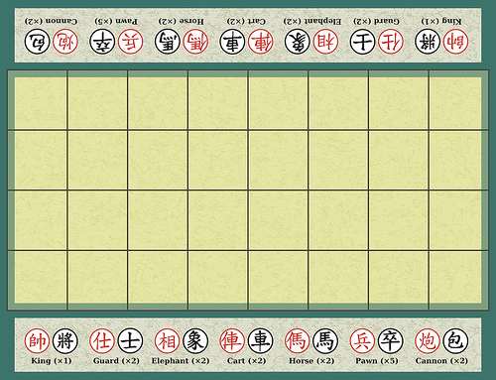
Banqi Setup
4x8 game board
32 total pieces (16 red, 16 black)
Pieces placed randomly face down
Pieces have different ranks
Name, Number per Color of pieces
General, 1
Advisor, 2
Elephant, 2
Chariot, 2
Horse, 2
Cannon , 2
Soldier, 5

Slide 4
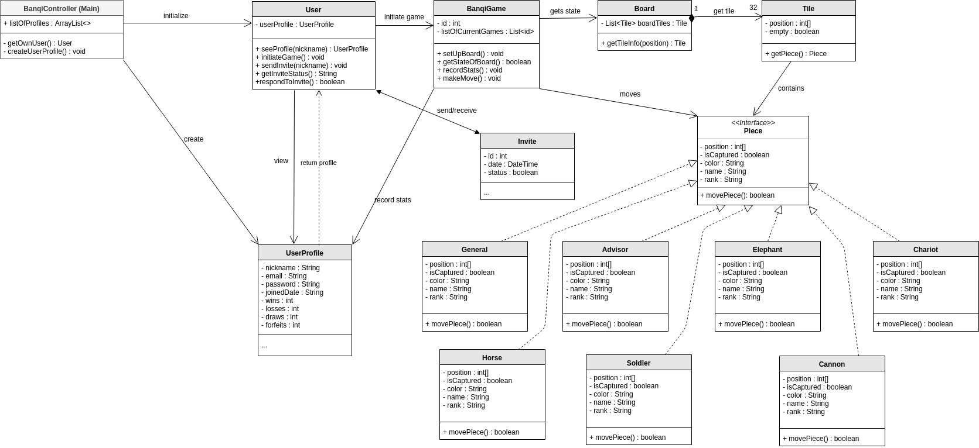
Design Class Diagram

Slide 5
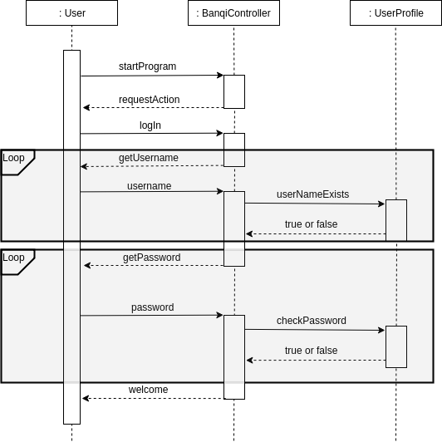
Sequence Diagram:
Log In

Slide 6
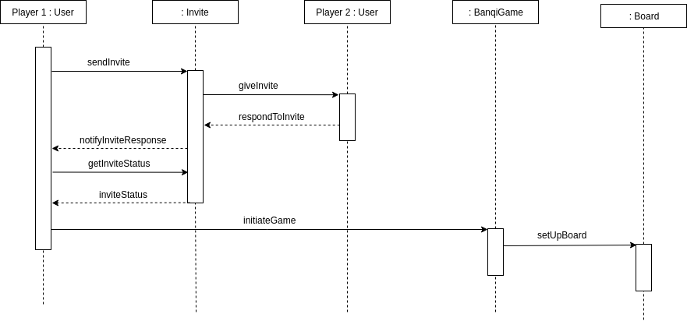
Sequence Diagram: Create Game

Slide 7
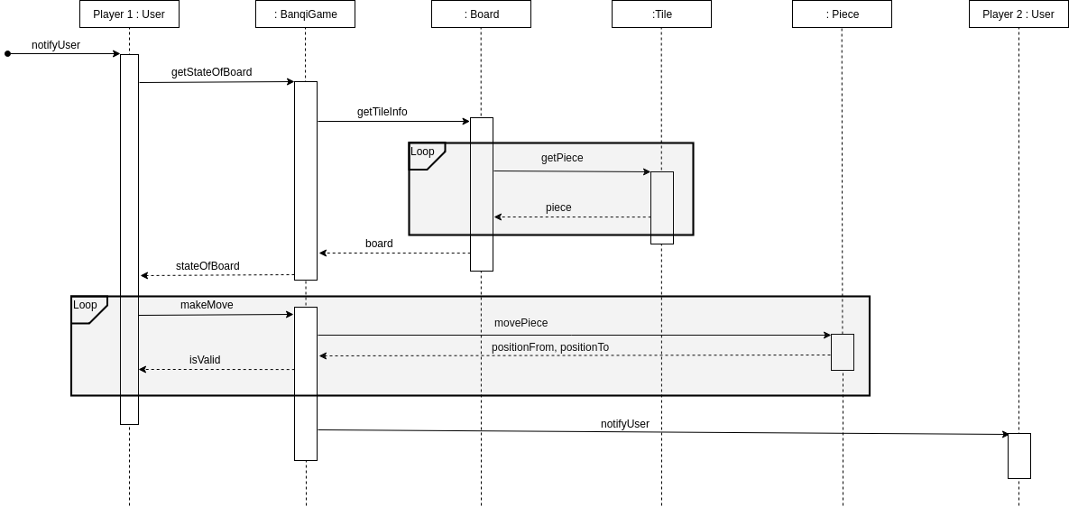
Sequence Diagram: Make Move

Slide 8
Testing Document
https://github.com/FoxXix/cs414-f18-001-ByteMe/blob/master/Sprint3/Testing%20Document.pdf

Slide 9
Development Manual
Manual sections:
Downloading the source code
Working on the project
Running the program
Testing the program
Manual: https://docs.google.com/document/d/1LL0N864aoAx-y-TVWxZu9jqQmLiqEo1ae0jkHb4blI0/edit

Slide 10
Traceability Matrix
 | Banqi Controller | User | User Profile | Banqi Game | Board | Tile | General | Advisor | Elephant | Chariot | Horse | Soldier | Cannon | Invite
Create User Profile | X |  | X
New Game | X | X |  | X | X | X |  |  |  |  |  |  |  | X
Play Game | X | X |  | X |  | X | X | X | X | X | X | X | X
Forfeit Game | X | X | X | X
View Profile | X | X | X
View Match History | X | X | X
View Board Status | X | X |  | X | X | X
Respond to Invitation | X | X |  |  |  |  |  |  |  |  |  |  |  | X

Slide 11
Planned Technologies
TravisCI (for Continuous Integration)
GitHub
ZenHub
Code Climate
Eclipse
Database (method TBD)

Slide 12
Demo

